Slide 1

Integrating Smooth Capabilities into Python
Filotas Theodosiou: VIVES University of Applied Sciences, Belgium
Ivan Svetunkov: Lancaster University, UK
Leonidas Tsaprounis: rogue
Notes:
Ok. So hi everyone. My name is Fil and I am a data scientist slash applied researchers at VIVES University in Belgium.
First of all, thanks Mitchell and everyone who contributed into organizing this super interesting workshop!!
My talk will also be on Smooth but from the pythonic side.
How we have successfully integrated it into python. To be honest I prefer the the world “translation” over integration but you can pick anyone you want.
So this is joint work from the team: Me, Ivan and Leonidas Tsaprounis, a data scientist based in London.

Slide 2


How it Started:
“Big progress on the Python forecasting ecosystem”
“Yeah, and it will be more!”
“I am thinking of a Python version for smooth”
“Cool idea”
“Indeed, the trend continued”
“Both for research and production-level applications”
“Maybe we should start actively working on smooth”
“Agreed!”
Notes:
Ok, fast forward 2024, Dijon France. Wine instead of beer this time.
We acknowledged that our predictions were correct and we agreed to start working on the translation of smooth.

Slide 3
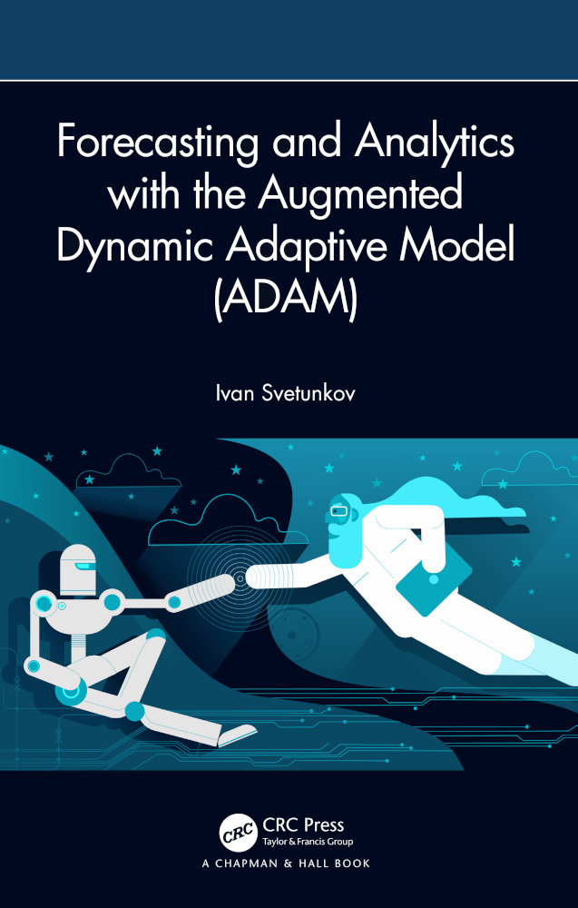

What is Smooth?
It is a package based on the Augmented Dynamic Adaptive Model:
Adaptive: Parameters change over time
Dynamic: We talk about time series
Augmented: More features than ETS/ARIMA
In short:
It unifies ETS/ARIMA/Regression based on (more) advanced statistical tools
Please refer to Kandrika and his presentation for more
Or here:
Notes:
So what is Smooth? Kandrika gave an excellent presentation on it so I wont spend a lot of time here.
In short, it is based on ADAM, The Augmented Dynamic Adaptive Model.
Adaptive for changing parameters over time, dynamic, well ok, time series
And augmented because it includes adddtional features over ETS and ARIMA
In a couple of words, it unifies core statistical models. But again please refer either to Kandrika or Ivan’s monogram which you can find here.

Slide 4

What this talk is about:
This talk is on the engineering part of Smooth!
Content:
R & Python. Two different worlds.
How we unify them in Smooth.
Lessons learnt.
Concluding..
NO!
Notes:
Instead, I briefly touch on some differences between R and Python
Then I describe how try to unify the two language in Smooth
What we learnt while doing that
And finally we conclude

Slide 5
R & Python: Two Different Worlds.
Notes:
Ok, lets first touch on a topic that was super hot some years ago on the data science community

Slide 6
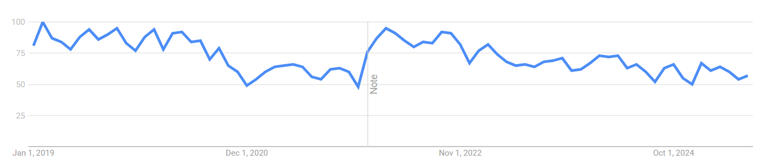

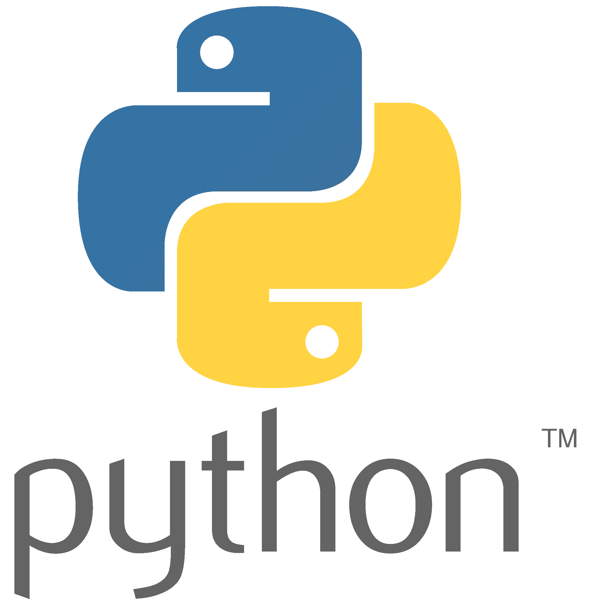
A Good Old R vs Python Slide.
The R vs Python Debate
More data modelling culture
By statisticians for statisticians
Loved by academics and econometricians
But how to deploy in production?
More algorithmic modelling culture
More “production-ready”
Loved by Data Scientists thanks to pandas, numpy, sklearn etc
What about the statistical frameworks?
(lets not talk about statsmodels, pmdarima)
Breinman, Leo. “Statistical modeling: The two cultures (with comments and a rejoinder by the author).” Statistical Science 16.3 (2001): 199-231
Notes:
On the other hand you have python, which is more algorithmic modelling. Its more on how do I find function f taking x and mapping it to y.
It’s a more production-ready language given its all around and not mainly focused on statistics.
Currently its loved by data scients thanks to excellent work on packages like pandas and numpy.
On the downside given that itsalogirhtmic culture its statistical frameworks are not so well established, especially for forecasting.
Yes there are some very good implementations but not on R level I would say.

Slide 7
Building a Package in R
CRAN
Integrate & Add dependencies
Bottom-up function-oriented
Streamline functions/methods
No universal API structure but core similarities
Built-in statistical toolbox
Internally optimized code for complex tasks
Classes are supported, but not essential
…
Write function Y
Document & Test
Write function X
Document & Test
devtools::create_package()
Notes:
On a more modelling side. When we want to develop a package in R we usually follow a bottom-up function oriented approach.
If you disagree with that its totally fine, its not a rule but a more generic framework
(expxlain the graph)
So what we are doing is streamling function.s one after the the other until we get the output.
There is no universal api structure, an excellent statistical toolbox is integrated and the language is optimized internally for complex tasks such as vectorization etc
Classes are supported but not essential so we don’t use them

Slide 8
Building a Package in Python
Python –m venv .venv
Top-down object oriented
Architect classes and APIs
Strong sklearn API conventions (fit/predict)
General purpose => relies on external foundational packages for different uses
Performance optimized via NumPy, built on the same principles as R internals
Build Class Structure
Write Superclass
Write Subclass X
Write Subclass Y
…
Methods & Functions
Methods & Functions
Pypi
Notes:
On the other hand, python is object oriented. When we develop a package we mainly follow a top-down approach
(explain it)
There is strong api structure, given the popularity of sklearn.
And as mentioned, it’s a general purpose library that is so great because of the great packages its build on.
For example numpy, uses the same principle for vectorized operations as the internals of R.

Slide 9
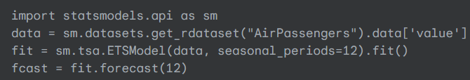
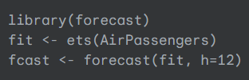
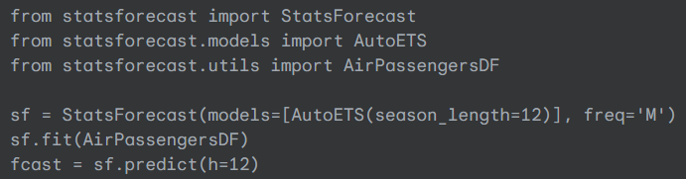
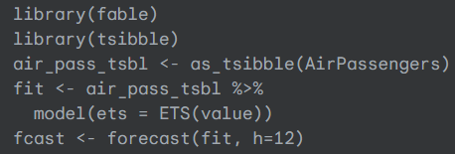
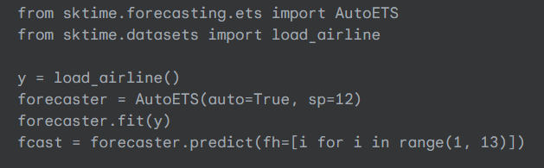
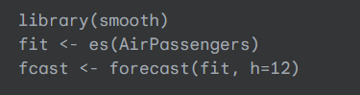
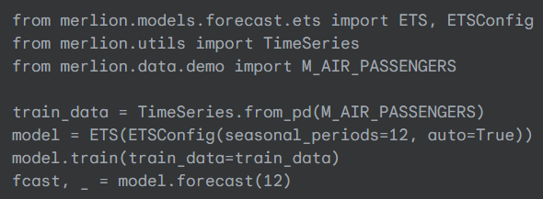
Different API Examples
Notes:
I have some examples here on different APIs from packages in R and python.
You can clearly see the different APIs, the different initializations, other takes dataframes with multiple time series, other singles
We have fit/predict forecast etc.
Then we have merlion which has their own unique api which is kind of weird but this is just my opinion so excuse me for that.

Slide 10
The Takeaway!
The two languages have some key differences (by construction and modelling-wise)
These leads to different results, computational time, goodness of fit for specific tasks
Very talented people have strong expertise on either language
Does that impact the development of the open-sourced forecasting ecosystem?
Open question
We focus on:
How can we assist in limiting cross-language differences?
Notes:
Instead I assume the answer is yes and turn the focus of the rest of the presentation on how we tend to bridge this gap on Smooth

Slide 11
How We Unify Them in Smooth!
Notes:
Ok, how we try to unify the two language in Smooth

Slide 12
The Smooth Ecosystem
Different
Losses
Multiple Seasonalities
ARIMA
ETS
Variety of
Distributions
Order and Components Selection
Regression (TVP)
CES
ADAM
Core
Different Initialisation Mechanisms
Scale Model
GUM
Variables Selection
Occurrence Model
SMA
Uncertainty Handling
Model Combinations
Notes:
First of all, this is Smooth’s ecosystem as Kandrika explained.
In the middle we have ADAM core, then we have some subclasses in the pythonic argo which are referred to the different models
And finally we have methods arguments utility functions for these subclasses
(give some examples)
An implementation of the thing within the same module

Slide 13



The C++ engine
ADAM
Core
Why? Well, speed!
A loop for a dynamic model in R takes several seconds.
In C++, split seconds!
But you could just write some model-specific functions
Ivan says: “Not fun”
So he sat down and wrote a generic core used by all smooth functions.
Notes:
Second question is; why a single function, you can use some model-specific c++ functions instead.
Which is what the nixtla guyes are doing in statsforecast and would be interested in learning details
The answer that Ivan gives: “it was not fun”
And he sat down and wrote a generic core for all functions.
“I am sure you have seen this emoji”, I don’t know what to say.

Slide 14
The Smooth Ecosystem
Different
Losses
Multiple Seasonalities
ARIMA
ETS
Variety of
Distributions
Order and Components Selection
Regression (TVP)
CES
ADAM
Core
Different Initialisation Mechanisms
Scale Model
GUM
Variables Selection
Occurrence Model
SMA
Uncertainty Handling
Model Combinations
Notes:
Anyways so back to the ecosystem. What we can do is change our core here, with this:

Slide 15
The Smooth Ecosystem
Different
Losses
Multiple Seasonalities
ARIMA
ETS
Variety of
Distributions
Order and Components Selection
Regression (TVP)
CES
ADAM
Core
Different Initialisation Mechanisms
Scale Model
GUM
Variables Selection
Occurrence Model
SMA
Uncertainty Handling
Model Combinations
Notes:
With this C

Slide 16
Bridging the Two Worlds
C++ can be viewed as “the backend”
R can be seen as the “front-end”
Interface can be language-specific
Backend guarantees identical results
Speed benefits remain
translate
Notes:
What does that mean, is that the backend should guarantee identical results + provide the speed benefits that offers to R

Slide 17
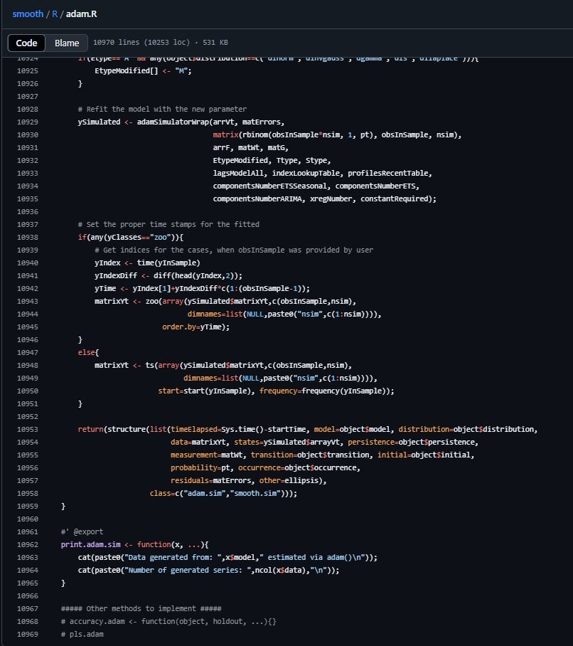
Translating Interfaces
Step 1: Adjust C++ integration to Python
Step 2: Translate the interface
Thanks for the ~11k lines of code/functions!
(and this is for ADAM only)
Notes:
Ok so when I agreed to take on the interface translation I was not informed that adam was like 11k lines of code.
Adam only
So yea, thanks for that. It took a while

Slide 18
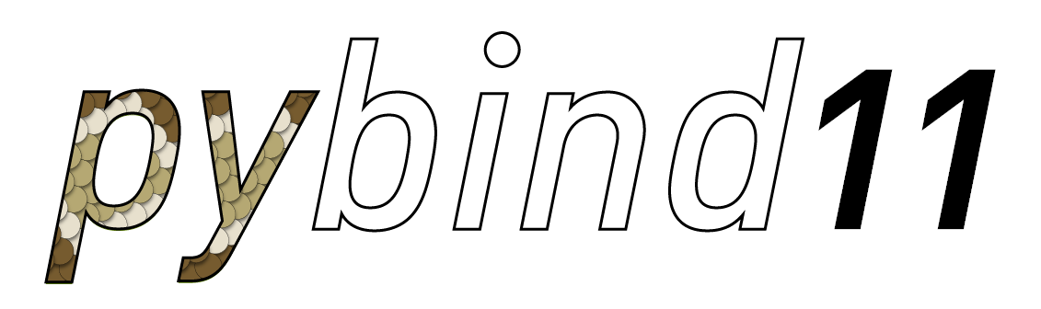






How does this C++ thing work?
Notes:
Finally, to easily build the python project without doing any gcc / cmake magic, we use scikit-build. With scikit-build the full project becomes pip-installable!

Slide 19

How does this C++ thing work?
Notes:
Yes, this is what it looks like.

Slide 20

How does this C++ thing work?
Notes:
The only difference is that Leo is the guy organized this whole thing.
But it works, so no further comments here

Slide 21
Translating the Interface
Core Functions
Checker
Creator
Estimator
Forecaster
ADAM (Main Interface)
A group of functions that validates and initializes parameters:
Model specification (ETS components, ARIMA orders, explanatory variables).
Observation data, lags, seasonal periods
Persistence vector (smoothing parameters) specifications.
Notes:
Explain it

Slide 22
Translating the Interface
Core Functions
Checker
Creator
Estimator
Forecaster
ADAM (Main Interface)
creator(): Constructs the core state-space matrices (measurement, transition, persistence, stat vector)
architector(): Defines the high-level model architecture and lookup tables
initialiser(): Prepares the initial parameter vector B for optimisation
filler(): Called by Cost Functions during optimization -> Updates model matrices based on B
Notes:
explain

Slide 23
Translating the Interface
Core Functions
Checker
Creator
Estimator
Forecaster
ADAM (Main Interface)
estimator(): Manages the estimation process (Initialiser => Runs Optimization => Calls filler)
selector(): Manages model selection based on pool of models and selects the best based on a criterion
CF(): Main Cost Function. Takes B and uses filler to optimize (uses adam_fitter from C++)
log_Lik_ADAM(): Calculates log-likelihood of ADAM model.
Notes:
Time depends on total paths sampled
Increasing the number of paths lower CRPS. There is a point of diminishing returns
Binned validation errors outperform empirical methods without computational overhead
KDE adds extra computation cost but gives better performance

Slide 24
Translating the Interface
Core Functions
Checker
Creator
Estimator
Forecaster
ADAM (Main Interface)
preparator(): Prepares fitted model for forecasting
forecaster(): Generates point forecasts (uses the adam_forecaster function from C++)
get_prediction_interval(): Generates predictions intervals
Notes:
Time depends on total paths sampled
Increasing the number of paths lower CRPS. There is a point of diminishing returns
Binned validation errors outperform empirical methods without computational overhead
KDE adds extra computation cost but gives better performance

Slide 25
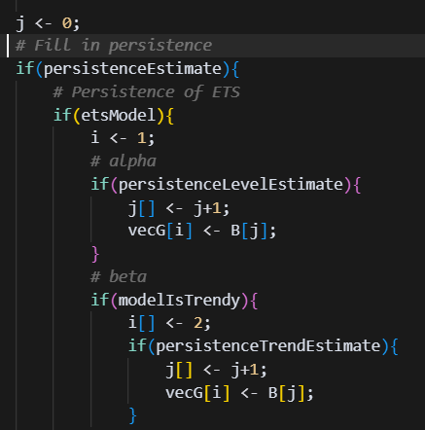
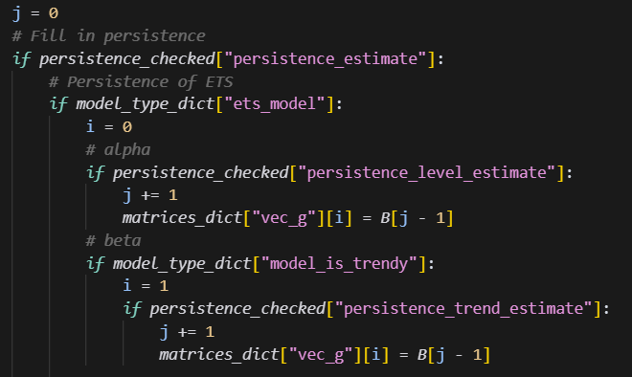
Our Translation Strategy
We perform a 1-1 translation
Function by function
Chunk by chunk
Why:
Retain functionality
Easy addition of new features
Notes:
Why we do that? We ensure 100% functionality and this makes it very easy to add new features

Slide 26
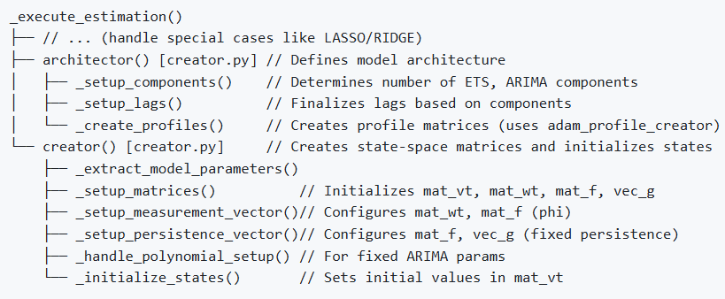
Pythonic Refactoring
Initial results were cool! But the code was ugly (sorry I mean not Pythonic at all)
Lets refactor it all!
Pythonic sklearn structure
Better code organization
(smaller utility functions)
Better error handling
Better documentation
Notes:
And ended up with a highly pythonic structure.
It follows the sklearn guidelines
Its better organized (you can see the smaller utility functions)
We have better error handling and excelent documentation

Slide 27
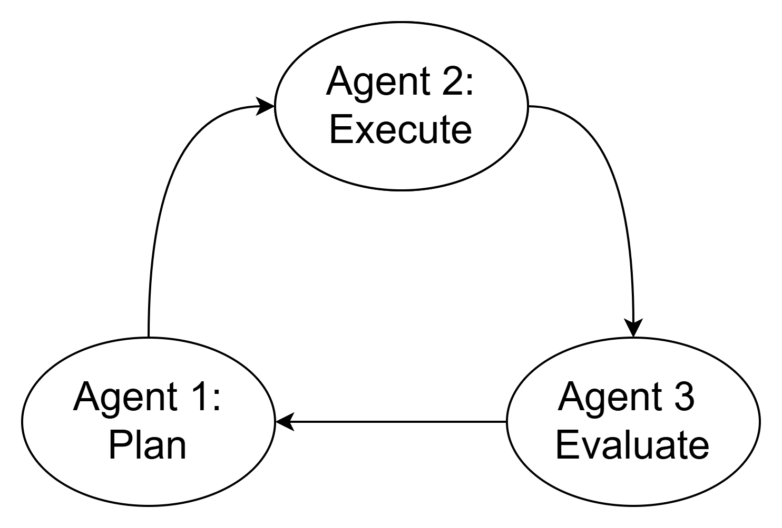
Pythonic Refactoring
Initial results were cool! But the code was ugly (sorry I mean not Pythonic at all)
Lets refactor it all!
For each core component
This is fast
This is not 100% accurate (Bonus: you kind of lose control)
Manual interventions and supervising are necessary
Notes:
Ok, while it super fast to make it, it was not 100% accurate. Agents, right?
So we did our manual adjustemnts

Slide 28

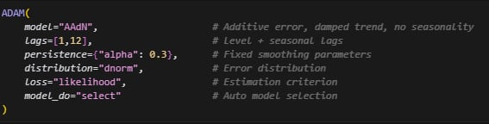
Current Status
Main components are integrated
Different loss functions & distributions are implemented
ETS works fine
Relatively easy to add new components
Sklearn compatible API
R-level parameter control
Notes:
And this is where we are at the moment.
The main components are integrated. You can see the sklearn based api, the R-level parameter control.
We fit on model per time series, similar to R.
ETS works fine, and its relative easy to add new features.
You can just translate the interface for ARIMA which is only something like one million lines of Ivan’s code.

Slide 29
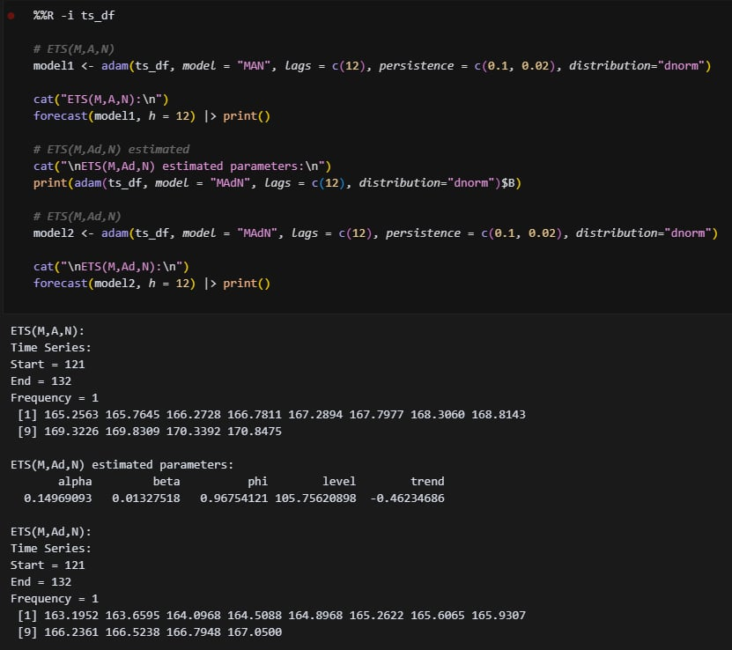
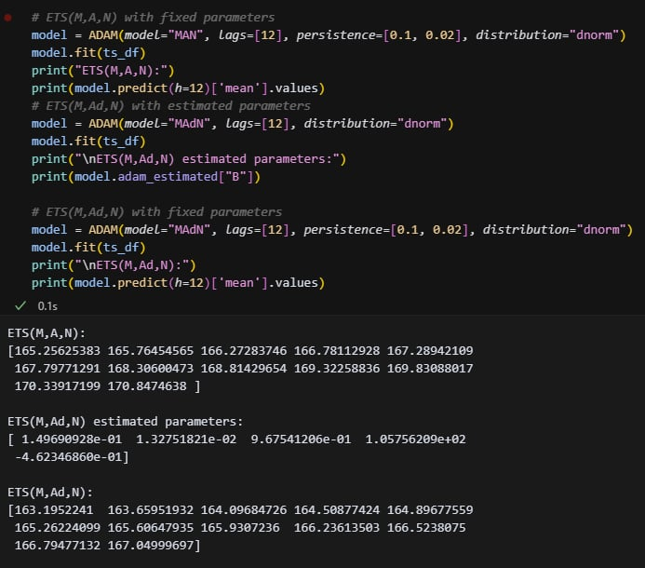
Quick Example
Notes:
This is a quick example of the two languages side by side
You can see we have the exact same results and the exact same parameters

Slide 30
Lessons Learnt
Notes:
Ok, to conclude, some lessons we learnt while we were cooking this

Slide 31
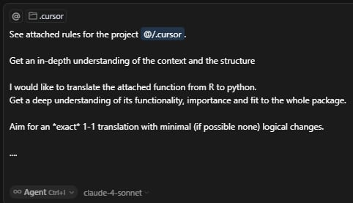
The Evolving Toolbox.
How long does it take to translate a small/medium function?
5 years ago: ~hour(s)
2023: ~ half an hour
Now: < 5minutes
And yeah, Estimator is over 700 lines.
Modern AI tools/LLMs provide significant productivity boost
Notes:
So yeah, pair cursor with sonnet 4 or gemini 2.5 pro and you have your toolbox.

Slide 32
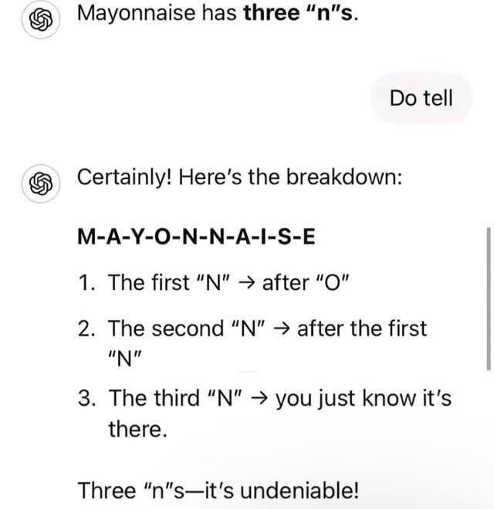
The Importance of Testing
Python –m venv .venv
Build Class Structure
Write Superclass
Write Subclass X
Write Subclass Y
…
Methods & Functions
Methods & Functions
Pypi
Notes:
So instead of usual workflow I described before

Slide 33
The Importance of Testing
Python –m venv .venv
Build Class Structure
Write Superclass
Translate function A
Automated
Manual inspect output
Test
Git commit –m
…
Add to class
Notes:
We go to this test-heavy approach where eash translated function is tested both automatically and by manual inspection before committing.
And yeah, I keep forget to commit so I add this here to assist.

Slide 34
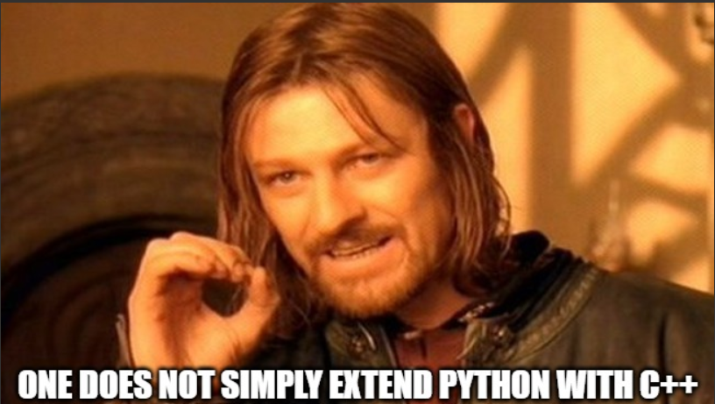
Building issues
The Problem:
Me and Leo know nothing about C++
Ivan knows knew nothing about Python
We had to figure out how to make the core functions available in Python:
Check what the “big guys” (lightGBM, PyTorch etc) are doing
We went from gcc - … to cmake … And then with scikit-build just pip install –e .
And yeah, we still have issues headaches with type conversions for CARMA (np.int64 etc) But now stuff works!
Notes:
What I can tell you is all the trouble I had with type converstion for CARMA and the gazillion of errors I had. But at least stuff now works.

Slide 35
Next steps
Things to implement and/or test in Python:
ADAM ARIMA
Simulator to generate data using ADAM
Regression ADAM style and introduce ETSX/ARIMAX
Multiple frequency models
Occurrence model and intermittent demand
es(), msarima(), ssarima(), ces(), sma()
...
Reconcile R and Python implementations again!
Ivan, please stop changing R functions already!
Notes:
And all of these, only if Ivan stops integrating new stuff.

Slide 36
Summary
R and Python have some important modelling differences
These difference might affect how researchers/practitioners approach open sourced projects
Smooth is a cool package with some advanced implementations of statistical models
Its core/backend is written in C++ and shared by all models
We take the R interface/frontend and translated it to Python using Pythonic APIs
Identical results are guaranteed
ETS is successfully implemented. Adding new features is straightforward
Notes:
And to conclude…

Slide 37





Thank you for your attention
Questions ?
filotas.theodosiou@vives.be
https://github.com/FilTheo
https://www.linkedin.com/in/filotas-theodosiou/
©mrsiraphol

